Slide 1
Ensemble River Stage Forecasts From the Site Specific Hydrologic Predictor
Al Cope
National Weather Service Forecast Office
Mount Holly, NJ
Nancy Furbush and Jeffrey Tongue
National Weather Service Forecast Office
New York, NY
Michael Erickson
School of Marine and Atmosphere Sciences
Stony Brook University, Stony Brook, NY

Slide 2
Introduction
Part of COMET Collaborative Project with SUNY-SB, MARFC, WFO OKX, WFO PHI (2007-2009)
Overall goal was to improve NWS short-term hydrologic forecasts and warnings, specifically using ensemble QPF as input to hydrologic models
SUNY-SB provided QPF’s from mesoscale ensemble forecast systems
MARFC implemented an ensemble river forecast system (MMEFS)
Initially WFO’s planned to develop an automatic procedure to use ensemble QPF with SSHP for small basins in real time, but eventually settled on retrospective case study approach
Notes:
The MARFC ensemble river forecast system (MMEFS) has already proved useful in operations.

Slide 3
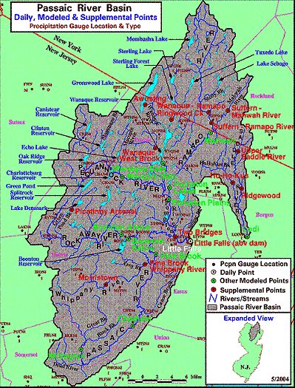
Passaic River Basin Study Area
Saddle River at Lodi (drains 54.6 sq. miles)
Whippany River at Morristown(drains 29.4 sq. miles)
Notes:
The Passaic River Basin is located mainly in northern New Jersey. The two headwater points used for this study were the Whippany River at Morristown, NJ (WHIN4), and the Saddle River at Lodi, NJ (LODN4). WHIN4 was not a regular forecast point and had to be added to SSHP. This required a rating curve (from USGS) and a unit hydrograph (from MARFC).

Slide 4
Data and Methods
Basin-averaged hourly QPF from past events were obtained from 13-member SUNY-SB ensemble (12-km) and 21-member NCEP SREF (32-45km)
QPF from each ensemble member were entered manually into SSHP to create forecast hydrograph
In some cases, the FFH parameter was adjusted to give “reasonable” results
Forecast hourly stages saved off and imported into spreadsheet
Notes:
The forecast hydrographs were created in SSHP, but were then displayed and saved using HydroView. For WHIN4, we used primarily the SUNY-SB ensemble. Since we were operating in retrospective mode, the operational headwater guidance for the event was not generally known. In some cases (like the one described later in this presentation), we entered the ensemble-mean QPF into SSHP, and then adjusted the FFH to give a forecast crest close to what actually occurred. Obviously, this could not be done in real time, but it still gives a sense of the range of possibilities.

Slide 5
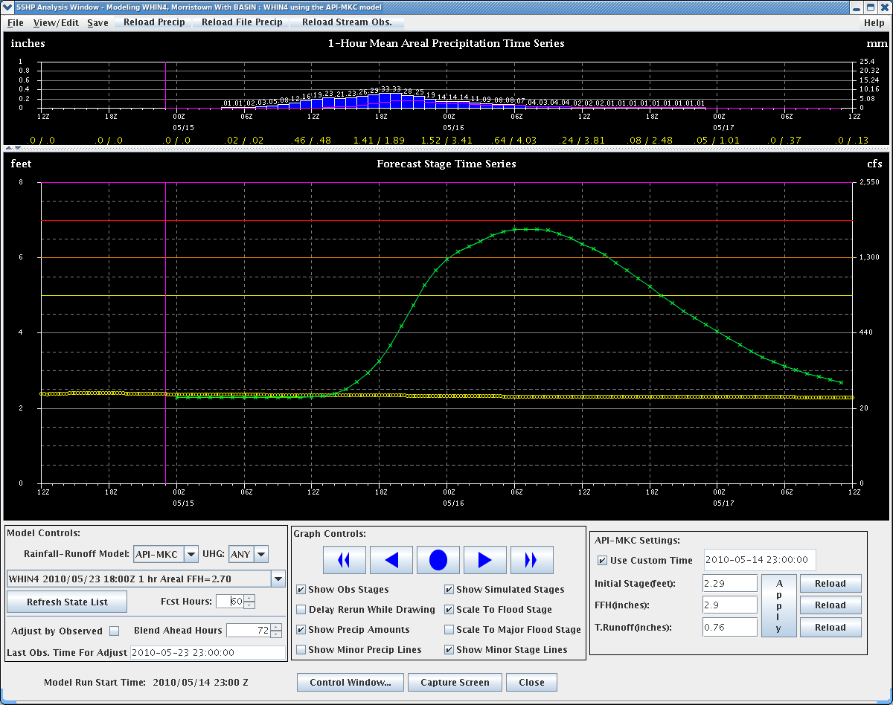
Example of SSHP Analysis Window
QPF
Forecast Hydrograph
Adjusted FFH
Notes:
Hourly QPF is manually entered (using the mouse/cursor) in the top part of the window. The resulting forecast hydrograph is in the middle section. Note, flood stage at WHIN4 is 6 feet. The FFH parameter was set to 2.9 to give a forecast crest of around 6.7 feet.

Slide 6
A Case Study Example: Whippany River at Morristown (WHIN4) March 13-14, 2010

Slide 7
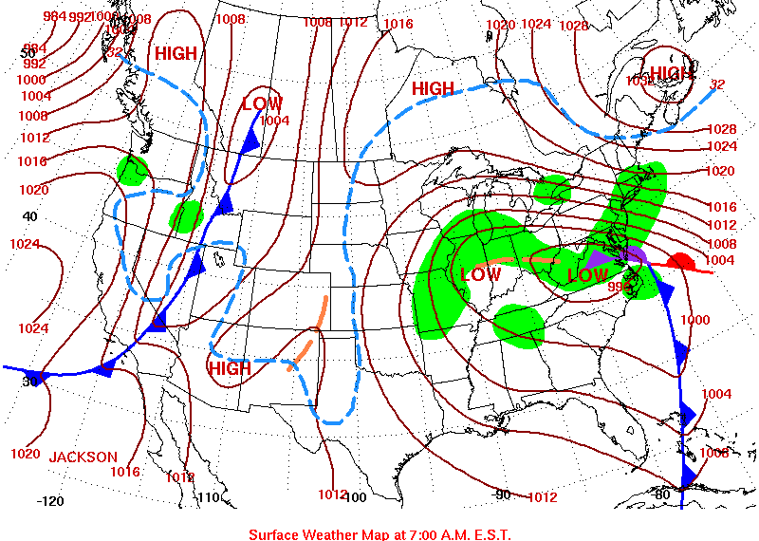
Surface Analysis, 1200 UTC, March 13, 2010
Notes:
A Nor’Easter case with strong low-level inflow off the Atlantic Ocean.

Slide 8
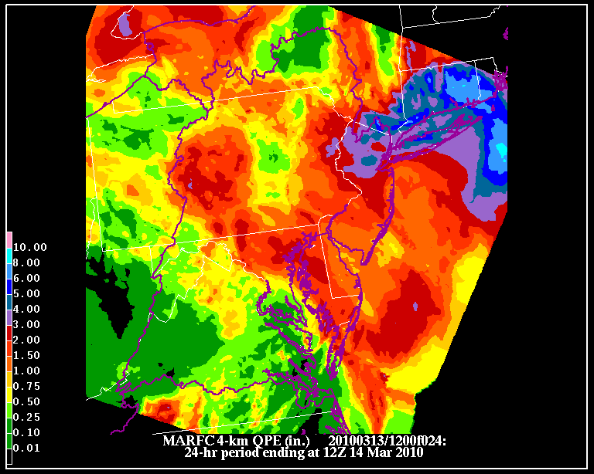
Estimated 24-hour rainfall,
(period ending 1200 UTC, March 14, 2010)
Notes:
This 24-hour rainfall total (not storm total) includes the bulk of the rain for this event over northern New Jersey. Storm totals were between 4 and 5 inches over two days. Even heavier amount occurred over southern New England.

Slide 9
Notes:
In the SUNY-SB ensemble, there are 7 members based on the MM5 model, and 6 based on the WRF.

Slide 10
Notes:
The total QPF from the various ensemble members ranges from about 3.3 inches to around 5.4 inches.

Slide 11
Notes:
The forecast crest from the ensemble mean QPF is close to the observed (by design), but there are still significant differences in the crest height and the timing.

Slide 12
Flood Timing* Hours Max Height
Ensmbl. Initial Max Below above stage Above Total
member FS stage FS FS (ft) FS QPF
mm51 3:00 5:00 11:00 8 6.52 0.52 3.81
mm52 10:00 14:00 21:00 11 6.41 0.41 4.12
mm53 2:00 11:00 24:00 22 7.76 1.76 5.41
mm54 2:00 10:00 22:00 20 8.28 2.28 5.36
mm55 6:00 10:00 23:00 17 7.40 1.40 4.97
mm56 7:00 12:00 23:00 16 6.93 0.93 4.77
mm57 n/a 15:00 n/a 0 5.60 -0.40 3.42
wrf1 2:00 11:00 22:00 20 7.71 1.71 5.19
wrf2 11:00 13:00 17:00 6 6.25 0.25 4.06
wrf3 n/a 6:00 n/a 0 5.87 -0.13 3.48
wrf4 2:00 7:00 19:00 17 7.74 1.74 4.76
wrf5 n/a 6:00 n/a 0 5.35 -0.65 3.33
wrf6 n/a 14:00 n/a 0 5.21 -0.79 3.49
Min 2:00 5:00 11:00 0 5.21 -0.79 3.33
Max 11:00 14:00 24:00 22 8.28 2.28 5.41
meanQPF 7:00 11:00 18:00 11 6.46 0.46 4.33
Obsvd 3:00 9:00 16:00 13 6.45 0.45 4.30
* All times are hours UTC on March 14, 2010
Notes:
This table summarizes the differences in the forecast hydrographs based on QPF’s from different ensemble members. In this case, 9 of the 13 hydrographs exceeded flood stage. Note, the greatest QPF does not necessarily produce the highest crest, nor the smallest QPF the lowest crest. However, the greatest QPF did produce the most hours of flooding.

Slide 13
Part 1 Conclusions
For the March 13, 2010 WHIN4 case, 9 of 13 ensemble QPFs produced flooding (~ 70% probability)
There was considerable variation among the ensemble forecast hydrographs in regards to timing and magnitude of flooding, even assuming the ensemble mean QPF was roughly correct
Maximum (minimum) total QPF does not necessarily produce the highest (lowest) crest; QPF timing and rate are also important
The procedure used in this experiment would be difficult to apply with SSHP in real time.
Notes:
Manually entering the hourly QPF’s from various ensemble members is rather time-consuming. It would be desirable to modify SSHP so that it could accept and process multiple QPF’s at once.

Slide 14
A Case From WFO New York’s Hydrologic Service Area
Jeffrey Tongue
Nancy Furbush

Slide 15
Surface Analyses at 1200 UTC, November 8 & 9, 2006

Slide 16
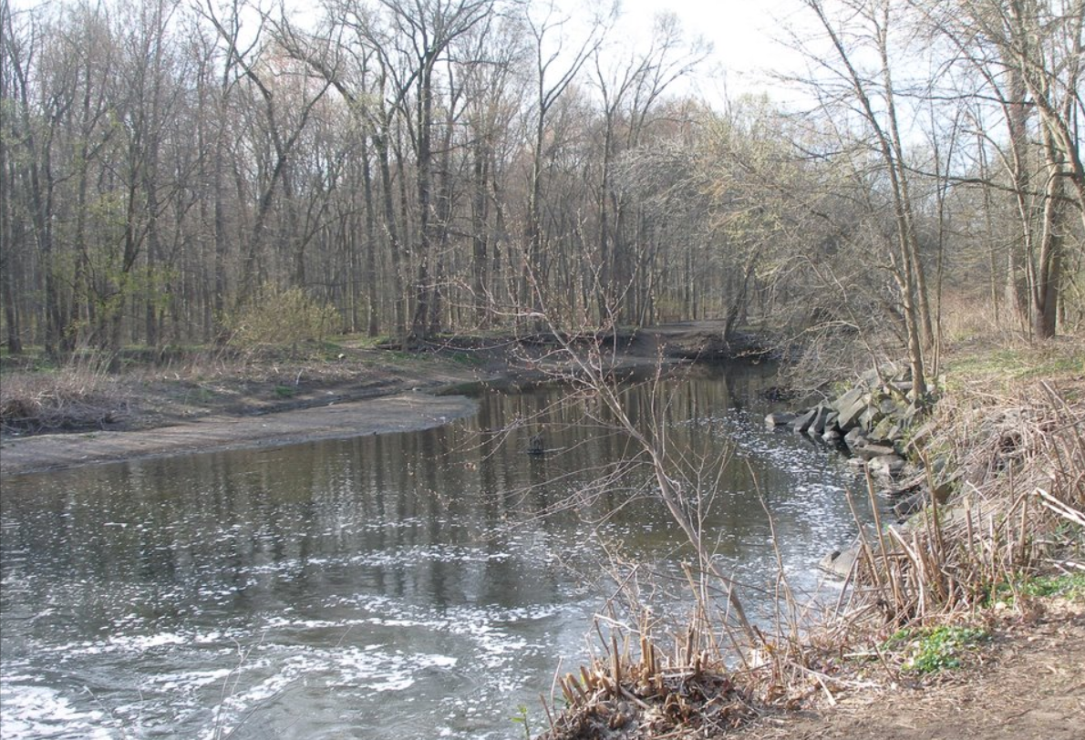
Saddle River at Lodi New Jersey

Slide 17
Synoptically stratiform in nature, but with embedded mesoscale features

Slide 18
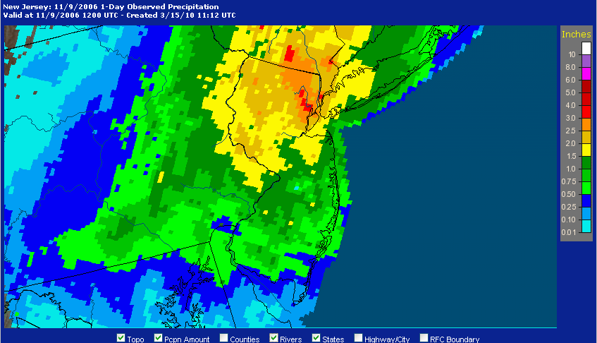
Radar Storm Total Under Estimated

Slide 19
Stony Brook EFS Precip (MEAN = 2.3”)

Slide 20
SREF Precip. (Mean = 2.2”)

Slide 21
Site Specific with SBU EFS Mean 4’ Observed 7.8’
ONLY ONE (1) Member Touches Flood Stage

Slide 22
Site Specific with SREF Mean 5.2’ Observed 7.8’
ONLY FOUR (4) Members Reach Flood Stage

Slide 23
Conclusions
Site Specific Hydrologic Predictor
Excellent with the Magnitude
Good Temporally
Flood Stage within an hour
Crest Too early (6 hours)
5 out of 28 members reach flood stage! (18%)

Slide 24
Project Results
Use of Site Specific Hydrologic Predictor
Use of Ensemble Forecast Systems in Operations building a new stochastic culture in Operational Hydro-Meteorology
New Understanding of Local Hydrology at the WFO
Need for EFS integration into the Site Specific Hydrologic Predictor.

Slide 25
THE END
Thank you for your attention!
Questions ???

